Slide 1
CSI 4133 – Project 4
Jean-Philippe Pellerin
Fall 2010

Slide 2
Hand Made Processing
Objective
Idea
… not such a good one
Better solution
Making it work
Adding in the tracking info
Being in the red
Final Results

Slide 3
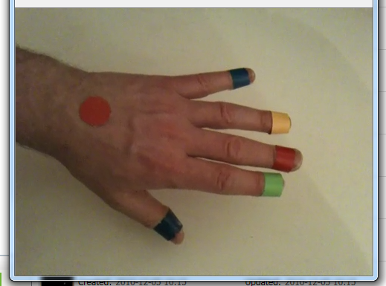
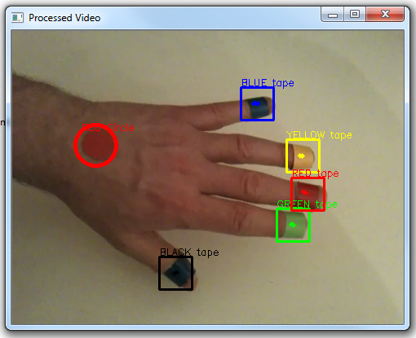
Objective
Taken from the Exercise 06 handout :
Goal: Track multiple objects in a video by using their colour, shape and movement information

Slide 4
Initial Idea
void cvGoodFeaturesToTrack( IplImage*, IplImage*, IplImage*, CvPoint2D32f*, int*, double, double);
The function cvGoodFeaturesToTrack finds corners with big eigenvalues in the image

Slide 5
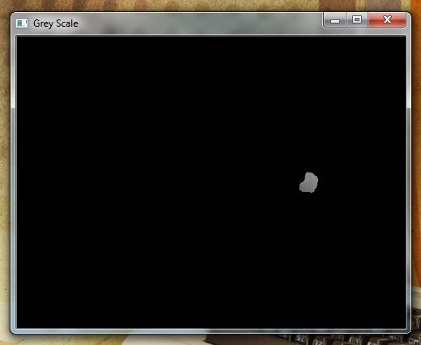
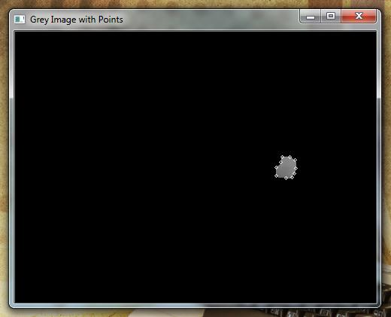
Initial Idea (visually)

Slide 6
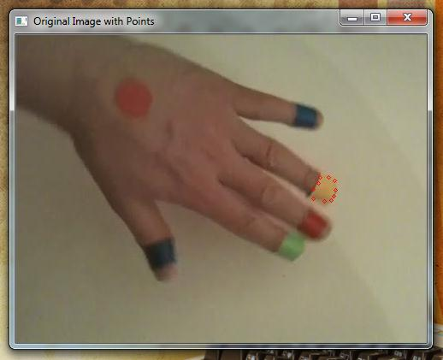
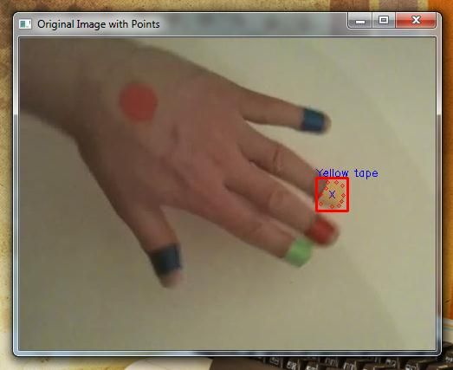
Initial Idea (visually – cont.)

Slide 7
Initial Idea (Problematic)
Finds corners
All colour section must be identified.
Relies on having only one « blob »

Slide 8


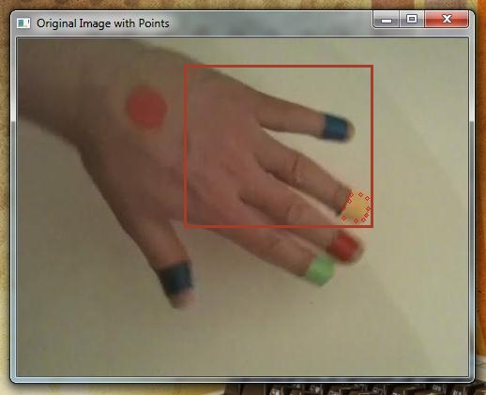
Initial Idea (Problematic – cont)
What if the same color is detected elsewhere?

Slide 9

Better Solution
void cvInRange( const CvArr* A, const CvArr* L, const CvArr* U, CvArr* C );
Basically Excercise 04 in one line.
Creates a binary mask of image fitting
the criteria (U < pixel < C)
Clean up result (dilate, erode)
Determine center of mass

Slide 10

Better Solution (cont.)
Calculate center of mass :
For all pixels that made the « cut »
Sum all x values
Sum all y values
Count number of pixels
(sum of X / nbPixels), (sum of Y / nbPixels)
Draw rectangle around

Slide 11
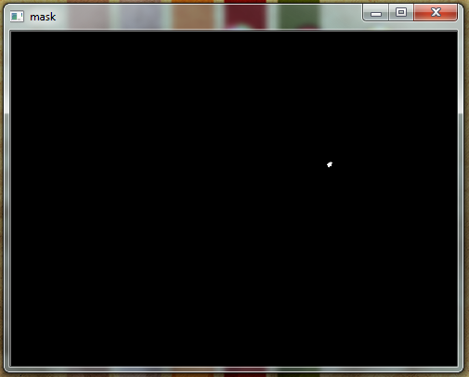
Advantages
Rectangle is not skewed by « rogue » pixel.
Can be strict on colour parameters
Somewhat efficient
processing time < 50 sec
for vidéo 1

Slide 12
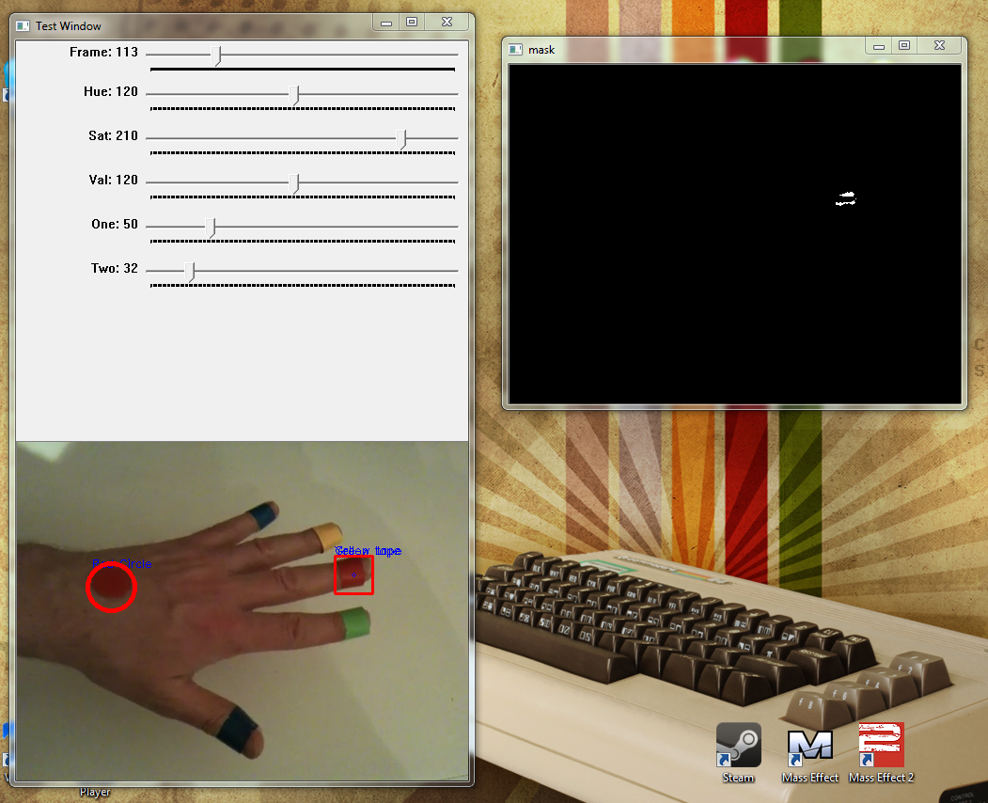
Making it work
Find proper colour values (HSV)
Tolerance = 10
Ex :
cvScalar(hue - tolerance -1, saturation - tolerance, 0)
 | H | S | V
Green | 70 | 120 | 115
Yellow | 95 | 160 | 165
Red | 120 | 210 | 120
Blue | 20 | 140 | 50
Black | 20 | 120 | 20

Slide 13
Adding the tracking info
Draw Rectangle
40px by 40px around center point
Add text
Motion dots
Array of 10 previous center points
Why not a queue?
Indexed using : (current frame number) mod 10
Print contents of array (for each colour)

Slide 14
Being in the red
Circular dot and figure marker are both red. How to make sense of the same color and identify differently?
What is the difference?
One is round (or nearly circular most of the time)
Slightly different HSV value
Can allow to be slightly more lax – need to define a circle

Slide 15
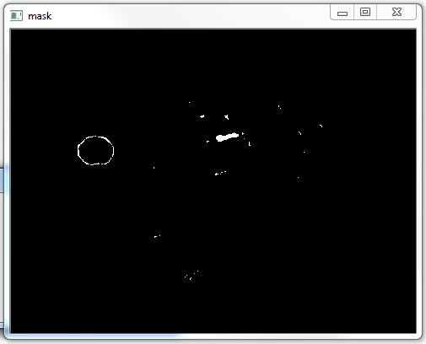
Being in the red
Leads to new HSV value for the circle

Slide 16
Making sense of the red
Find the circle in the first pass
IntPtr cvHoughCircles( IntPtr, IntPtr, HOUGH_TYPE, double, double, double, double, int, int );
Once circle is identified, save center point, then find red finger
Do not include pixels near circle when calculating center of mass.

Slide 17
Final Results
Video 1
http://www.youtube.com/watch?v=yGtEezvW_KU
Video 2
http://www.youtube.com/watch?v=xTslfUSRAus
Video 3
http://www.youtube.com/watch?v=zVbHHRuR9N8

Slide 18
References
http://www.geckogeek.fr/tutorial-opencv-isoler-et-traquer-une-couleur.html
http://www.moosechips.com/2008/08/opencv-corner-detection-using-cvgoodfeaturestotrack/
Previous projects and their references

